Slide 1
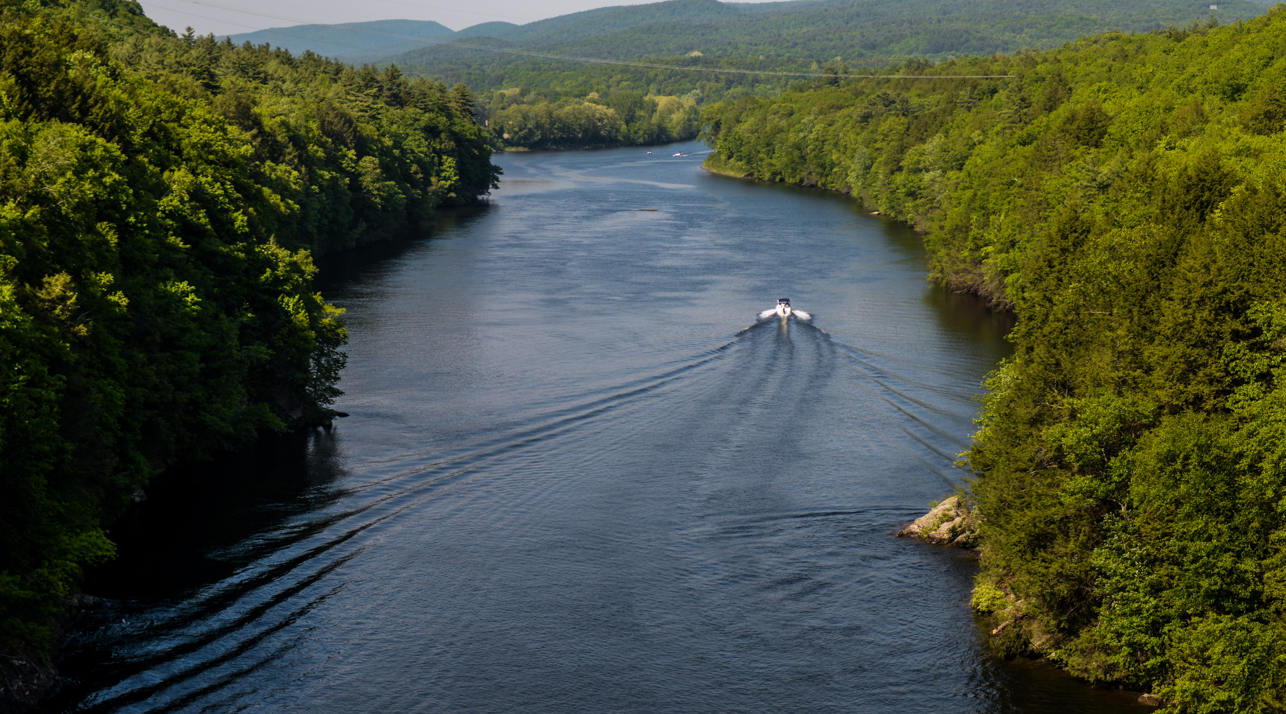
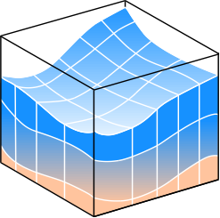

Presentation of Data for the Development of a Boat Wave Detection Model Using Pattern Recognition
William Rossell
Advisors: Hakan Yasarer and Yavuz Ozeren

Slide 2
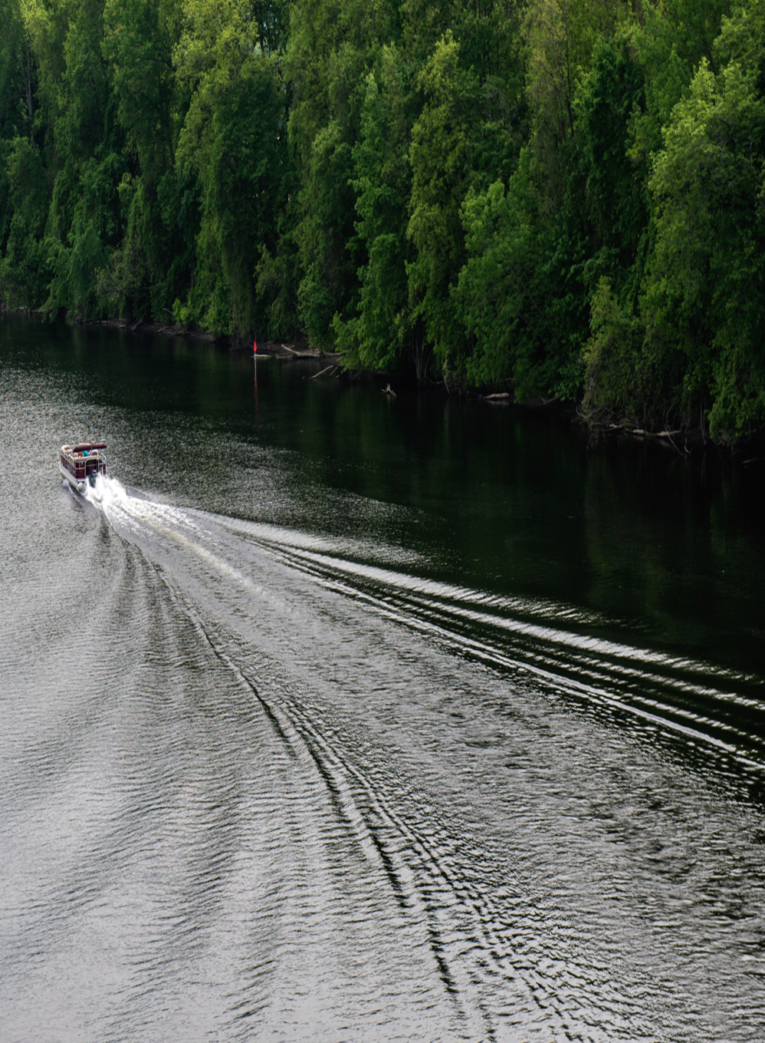
Introduction
A major component of riverbank erosion is wave action, which in most cases are due to wind or boat traffic.
Despite the impact of boat-generated waves to the bank erosion, the availability of historic boat generated wave (BGW) data for study is extremely limited relative to data regarding wind generated waves.
BGW created by high-speed vessels are capable of producing wave heights sufficiently high enough to cause significant damage to the riverbanks.
The energy transmitted to the banks from BGW can be up to 60% of energy of the streamflow.

Slide 3
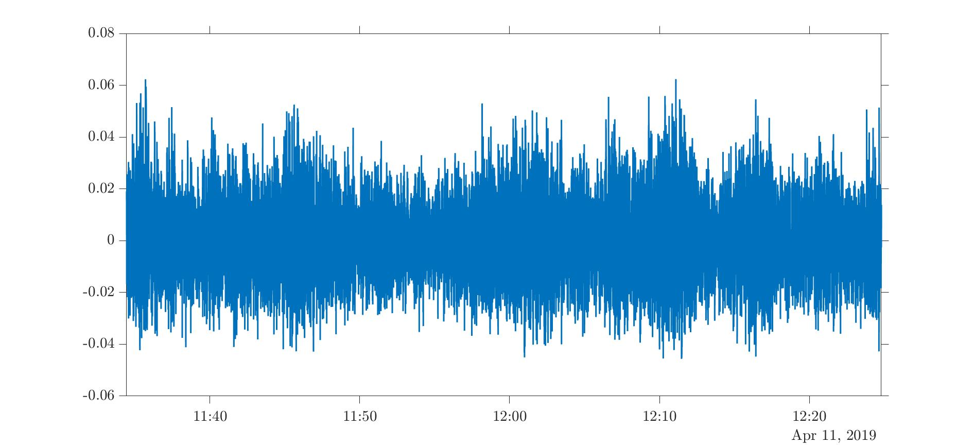
Introduction
The relative contribution of BGW to erosion depends on a many variables and complex shoreline dynamics.
Direct assessment of BGW impact on the riverbanks requires the knowledge of the characteristics of these waves.
Where are the Boats?

Slide 4
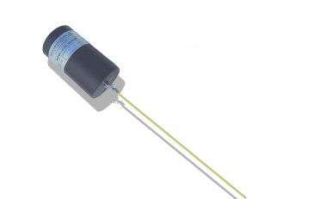
Data Acquisition
OceanSensor Wave Logger
Self Powered
Capacitance Type
Analogue/Digital Output
Length: 2 m
Frequency: 30 Hz
Notes:
Water level variations cause a change in capacitance which produces proportional output.

Slide 5
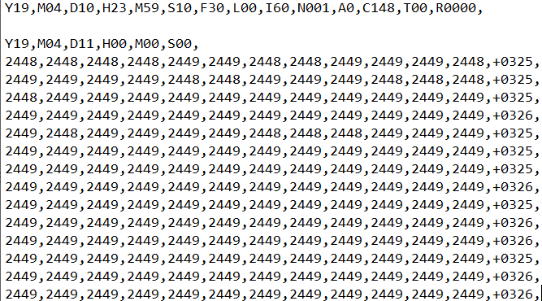
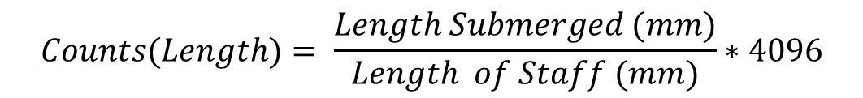
$$Counts(Length)= \frac{Length Submerged (mm)}{Length of Staff (mm)}∗4096$$

Slide 6
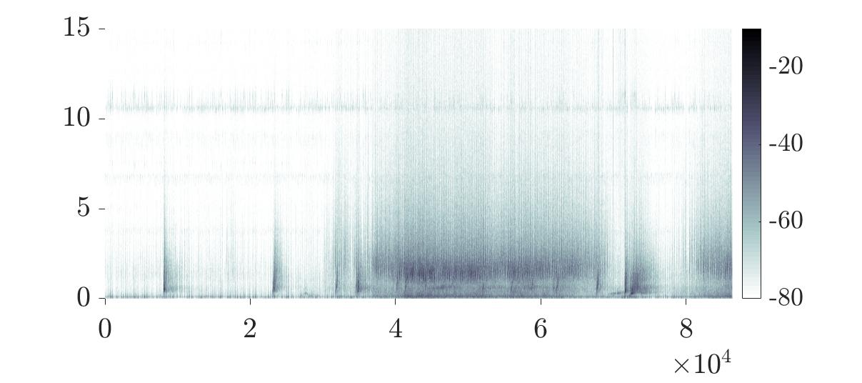
Summary of the wave data analysis/cleansing
Separate the water surface fluctuations, η(t), , and mean water level, z(t), from within the measured water level signal using a low pass IIR filter.
Apply windowed Fourier transform to find the spectrogram (Hamming window of size 512 with 75% overlap. The windows are approximately 17s long and 4.25s apart, center-to-center)

Slide 7
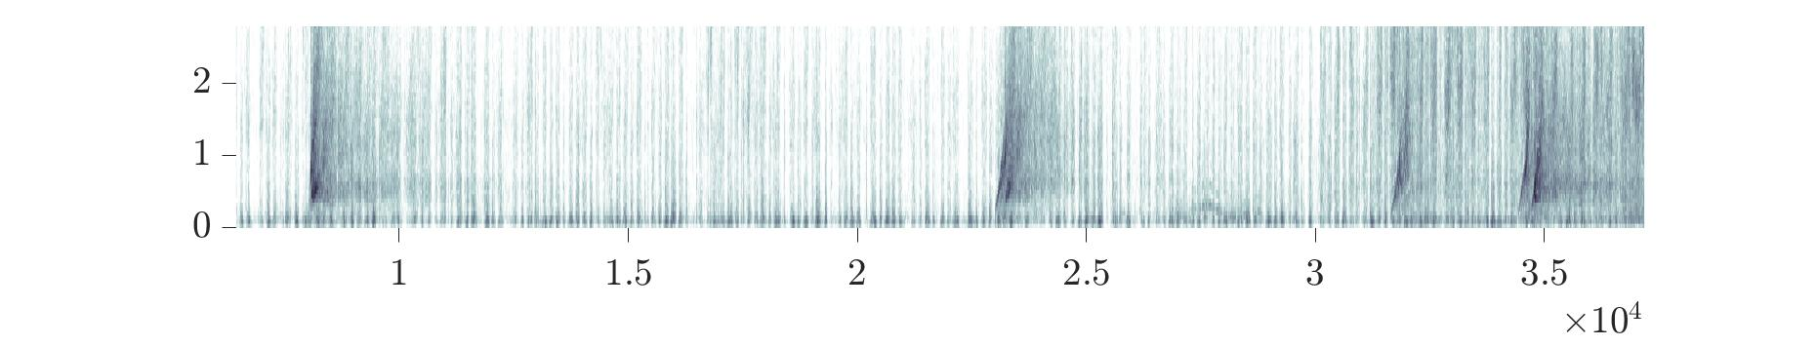
Boats can be identified within the spectral data due to the sudden increase of amplitude in the lower frequency range.
In consult with Dr. Yasarer and Dr. Ozeren, it was decided that developing a tool capable of identifying this phenomena would require the use of a static model and requires one more reformation of data.

Slide 8
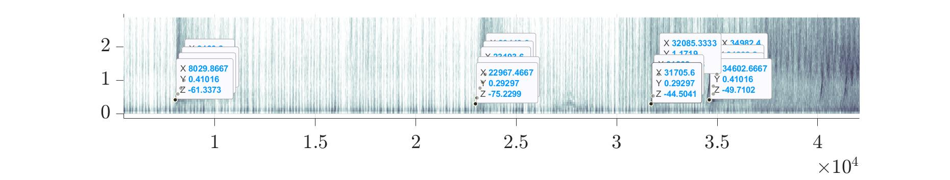
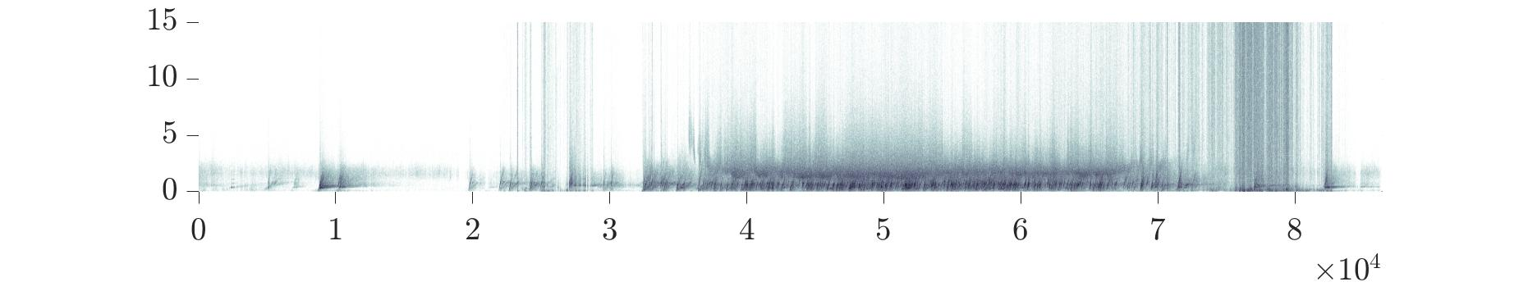
In order to retain the attributes of the phenomena signature, information on frequency, time, and power response is being manually retrieved from the spectrograms of several days of interest in order to train a model.

Slide 9
Inputs
Outputs
Spectral Frequency
Spectral Power
Spectral Time Signature
Month (?)
Weekday (?)
Boat?
No Boat?

Slide 10
Questions?

